Slide 1
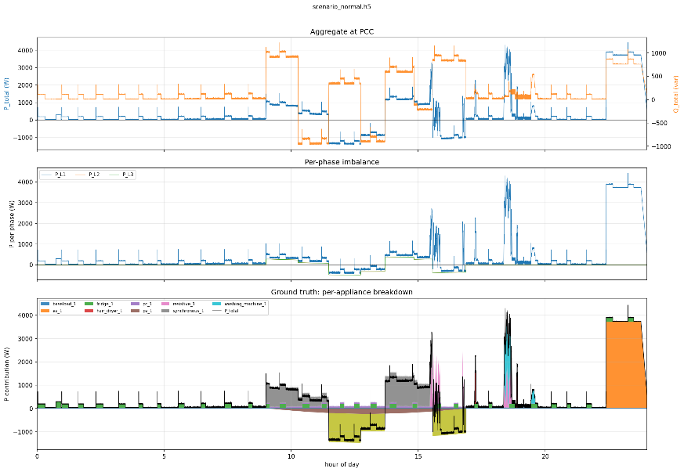
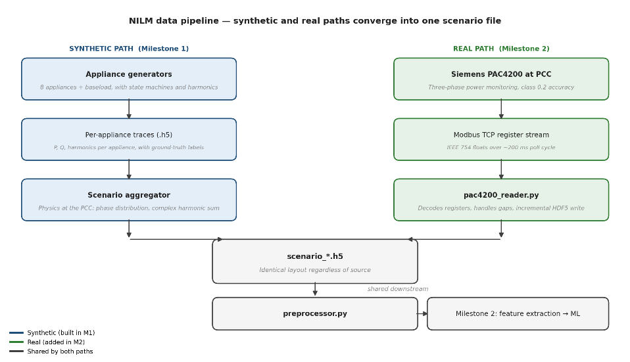
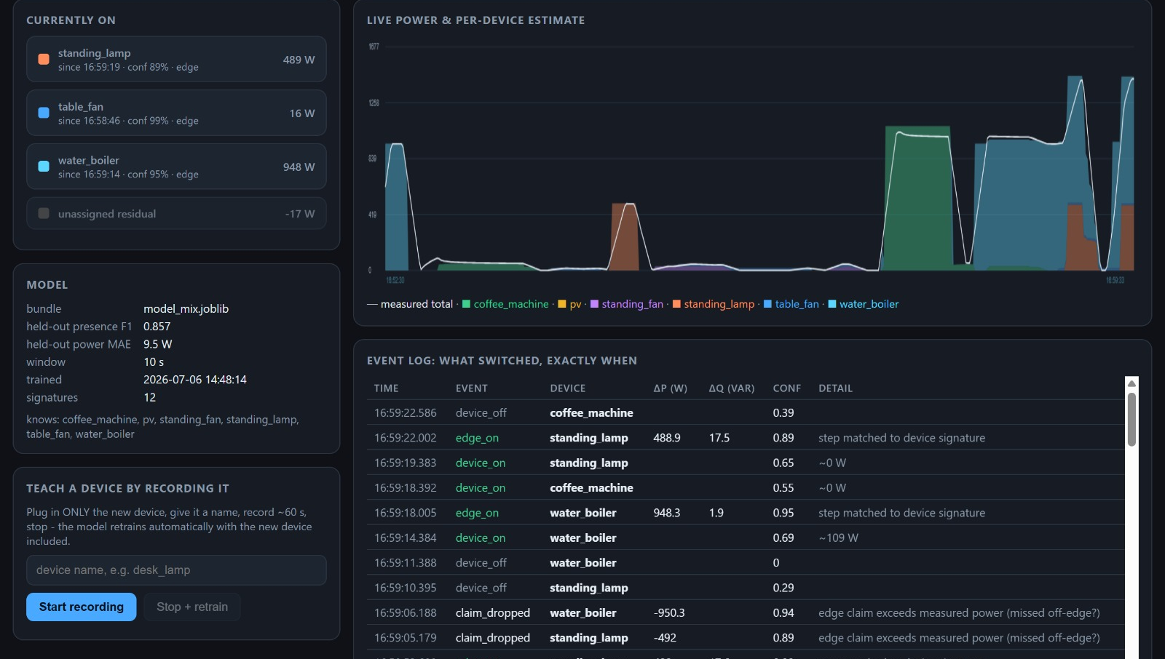
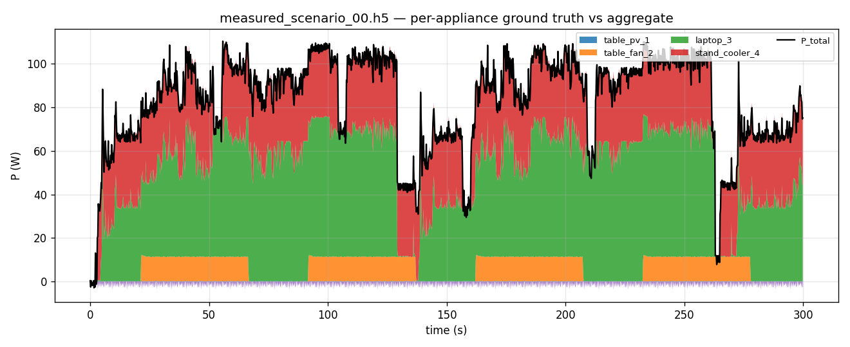
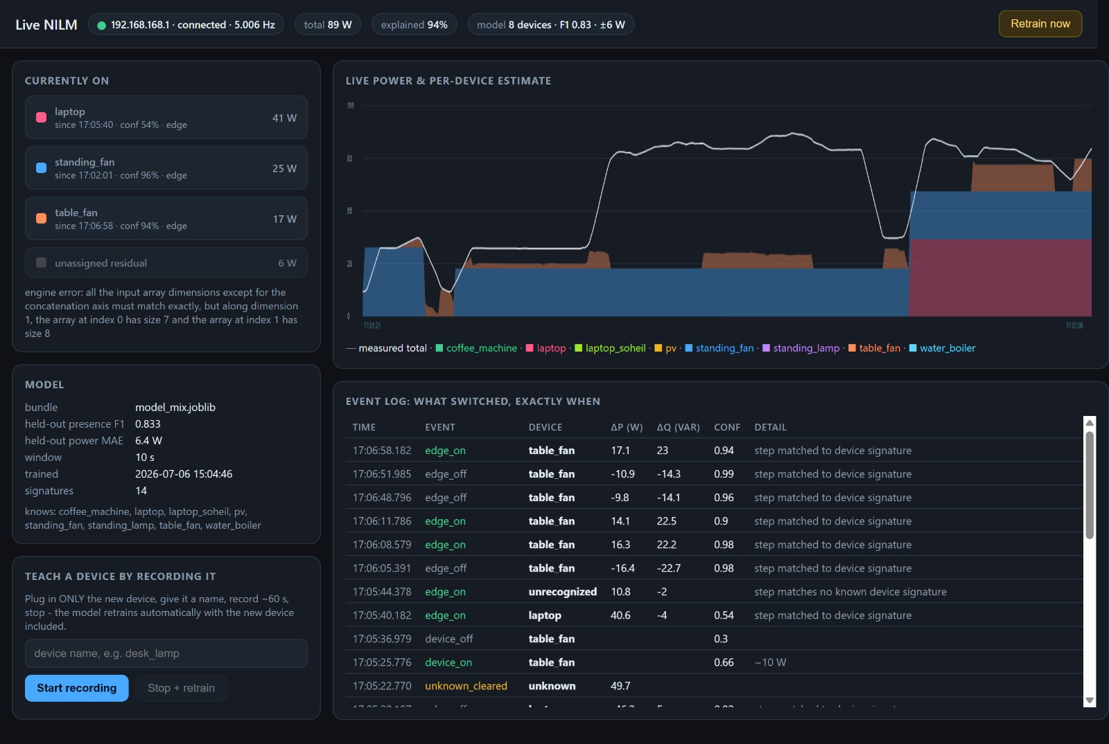
Non-Intrusive Load Monitoring
with Harmonic Feature Fusion
and Live On-the-Go Learning
Modeling, Simulation and Automation of Electrical Energy Systems
TH Köln | Soheil Ayati, Marc Steffgen
A complete laboratory NILM workflow: PAC4200 acquisition, HDF5 ground-truth scenarios, physics-aware PCC aggregation, a deployable Random Forest presence/power mix model, residual-aware live inference, and guided retraining for unknown devices.
Why we built it
Implementation focus
Results and limits
NILM estimates appliance activity from one aggregate measurement at the point of common coupling.
The practical challenge is overlap: several devices run at once, similar loads share the same P range, and PV can mask consumption by driving signed power toward zero.
The project therefore uses every measurable low-frequency signature: active/reactive power, power factor, THD, per-order harmonics and switching edges.
Data aggregation
0.916
2.9 W
0.955
One format: every source normalizes to a single HDF5 layout, UTC-microsecond timestamps, float32 channels, optional ground truth, LZF-compressed.
Two supervision sources: synthetic traces give exact per-sample P/Q/state labels; measured single-device recordings give real signatures, looped by the mixer into labelled multi-device scenarios.
Physical PCC model: single-phase loads land on L1-L3, balanced devices split three ways, signed PV can pull net P below zero; totals P/Q/S/PF/THD recomputed.
Complex harmonic sum: orders 1..40 added as vectors per phase and kept as magnitude and phase, so harmonic cancellation and reinforcement survive what plain magnitude addition would destroy.
Mix presence
macro-F1
Gated power
MAE
Identify
macro-F1
1920 measured
windows
10 s, 7 families
Presence-gated
watts shown in
the dashboard
Real active
windows
row split caveat
Evaluation protocol
Loads
+ PV
PAC4200
5 Hz
NILM
who + watts?
Mix: 1920 measured-scenario windows, 10 s each, 5 W ON threshold, seven-device vocabulary.
Metrics: presence macro-F1 for ON/OFF; gated power MAE (2.9 W) is the deployed dashboard number, raw MAE is tracked alongside.
Identify: 171 active real-device windows with common plus harmonic features; the row split is useful but optimistic.
Remaining risk: repeated sessions and true simultaneous recordings are still needed for leakage-free validation.
Figure 1: Single-meter NILM objective under overlapping loads and PV-aware signed power.
Implementation plan
What worked
End-to-end loop works: record, aggregate, train RF mix bundle, infer live, detect unknowns and retrain.
The central technical pair is aggregator + RF mix model: the aggregator creates a physically meaningful PCC view with ground truth; the RF bundle maps 17 aggregate features to presence and watts.
Live validation detected an unknown residual after 8 s, retrained in 26 s, then re-recognised the taught device with 0.95 confidence and 97.9% explained power.
The high-load test split about 1.44 kW into water boiler, standing lamp and table fan with about 99% explained power.
Figure 3: 24 h PCC aggregate and hidden per-appliance ground truth; the model sees only the aggregate signal.
Random Forest mix model
Figure 1: Architecture decision: synthetic appliance generation and real PAC4200 acquisition are different front ends that converge into the same scenario format. This made later ML and live processing source-agnostic instead of requiring separate code paths.
Two questions per 10 s window: which appliances are ON, and how many watts each one contributes.
Model: presence is a MultiOutputClassifier of Random Forests; power is a MultiOutputRegressor with one RF per appliance family.
Presence gates power: OFF forces watts to 0, so the dashboard shows plausible device power and leaves the rest as residual.
17 features: steady-state P/Q/S/PF, per-phase split, THD_I, hour-of-day, and three switching-step cues; the 5 per-order harmonic features are added only when every training source carries a real spectrum.
Why RF: robust on a small measured corpus, fast enough to retrain inside the teach loop, transparent enough to debug features, vocabulary and metrics.
The core idea is source-agnostic processing: synthetic data and real PAC4200 meter recordings are collected differently, but afterward they follow the same workflow.
Synthetic scenarios provide controlled training data with exact measurements for each appliance. They can also model challenging conditions, such as solar generation masking electricity consumption. Real recordings capture device behavior and laboratory conditions that simulations may not reproduce accurately.
From that point onward, they use one shared pipeline for preprocessing, aggregation, feature extraction, random-forest training, inference, and live monitoring. This unified design connects controlled simulation with a practical, deployable NILM system.
Figure 5: Live high-load dashboard from the paper; water boiler, standing lamp and table fan are split with about 99% explained power.
Edge detection
What can be improved
Faster than the window: a step detector runs on raw live P/Q, catching switches before the 10 s RF window has filled.
Settled medians: it compares pre/post medians over the last 8 s, rejects noisy states, and emits dP, dQ and a millisecond timestamp.
Edges drive state: a matched ON edge claims the device at its own watt step; a matched OFF edge releases it, so the UI reacts immediately.
Fusion: RF presence probabilities are median-smoothed and passed through hysteresis (0.55 ON / 0.45 OFF); final state merges RF predictions, edge claims and residual power.
Record real PV reliably during actual generation; current PV recordings contain almost no generated power.
Measure several sessions per device and more variants of small fans, then use grouped evaluation by session.
Run ablations for common vs harmonic features and with/without event features; report gains only once measured.
Try CNN/LSTM or seq2point for long appliance cycles such as washing machines.
Validate real simultaneous multi-device physics, because measured training mixes currently loop isolated recordings with random schedules.
Key implementations
Data recording: One persistent Modbus TCP connection, 5Hz polling, session HDF5 writer and harmonic file-record acquisition.
Data aggregation: Phase allocation, signed P/Q summation, synthesized voltage/frequency, complex harmonic summation and ground-truth tensors.
Scenario generation: Real single-device recordings looped with random ON/OFF schedules and coverage guarantees into labelled, multi-device measured scenarios.
Training: RF mix model on 17 steady-state, phase, harmonic and transient features over 10s windows.
Live demonstration: Presence-gated power output, edge-claimed device states, residual monitor and teach/retrain hot reload, flagging an unknown device in 8s, retraining in 26s and recognizing it at 0.95 confidence with 97.9% power explained.
Training-on-the-go
Trigger: the residual monitor flags unexplained power above max(12 W, 15% of total) held for 8 s.
Capture: the UI asks for a device name, then records an OFF baseline, isolated ON operation, and OFF tail, giving the new label one clean signature.
Retrain and reload: measured scenarios are rebuilt, the mix and identify bundles retrain in the background, and the live engine hot-reloads them without a restart.
Conclusion
Within its constraints the result is a complete proof of concept, not only a classifier: it records, trains, infers, explains confidence, logs events, detects the unknown and updates itself. That moves NILM from an offline score toward an operator-facing system that can be used and improved in a real laboratory.
Figure 2: A scenario mixed from real recordings: the stacked per-appliance ground truth sums exactly to the aggregate the model sees.
Sources
Figure 4: Residual gaps being recorded between detected device (colored surfaces) and total power (white line) as unknown device
Our up-to-date documentation of all parts of the software
Sources: project paper; Docs/01_data_format.md; Docs/09_design_rationale.md; Docs/MS3 notes; aggregator.py, nilm_pipeline.py, train.py, live.py, pac_reader.py; Hart, Reddy, Papageorgiou, Siemens PAC4200 manual.

